Slide 1
Data Analytics
An analysis of Crime patterns in India

Slide 2
Project Goals
Through the course of human civilization, law and order has been a constantly pressing issue, dealt by monarchs and democracies in varying ways. In this project, we look at predictability of yearly totals of crime (concentrating on burglaries) in districts of Karnataka and in India in general, given census data detailing characteristics of ethnicity, education, employment, population, transport, environment (natural and built) for every neighborhood. One hopes that this may be of use to social scientists, criminologists, law enforcement agencies and city planners. The main focus is to develop a crime analysis tool that assists the police in:
To perform crime analysis to detect crime patterns.
Provide information to formulate strategies for crime prevention and reduction.
Identify and analyze common crime patterns to reduce further occurrences of similar incidence.

Slide 3
Data Set
The raw census data from 2013 was collected, maintained and published by the Government of India at the link http://data.gov.in

Slide 4
Description of Data Sets
Population - Number of residents in 2013, in all the districts of Karnataka.
Crime - Major, minor and other crime reports, number of murders, rapes, aggravated assaults, robberies, burglaries, auto-thefts and drug violations.
Housing - Total number of units, occupied vs. vacant units, renter vs. owner occupied units, break up decade of construction, median home value, foreclosures and sales.
Employment - Total number of employed residents and breakup by type of job, number of jobs located in neighborhood and breakup by type of job.
Education + Income - Breakup of population based on levels of literacy rate, Gross Domestic District Product, per Capita Income, and median income in 2013.

Slide 5
Contd.
Demographics – Breakdown of different regions based on the sex ratio, density and district area.
Land Use - Total area, breakup into residential, commercial, industrial, institutional, open spaces, hillside and special uses.
Built Environment - Number of parcels and structures and breakup according to their condition, residential and commercial building permits, code violations, condemned structures, demolitions and tax delinquent property.
Natural Environment - Percentage of landslide-prone, undermined and flood plains, breakup into park space, woodland, greenways, cemeteries and street tree counts.
Police Stations – Number of subdivisions and circles in each of these districts, along with the city police stations, traffic police stations and women police stations in each of these.
Religion – Segregating people into different sections of religions.

Slide 6
Description of SRS
1. External Interface Requirements
  User Interfaces
The user can interact with the system through a website. The end user can view the visualization of the previous data, based on district and on the type of crime committed. The prediction can also be done extrapolating the previous data and is represented graphically.
  Hardware Interfaces:
Any kind of hand held device or computer with a processor and browser.
  Software Interfaces
R toolkit is used to do the back end processing.

Slide 7
  Communication Interfaces
The communication between the different parts of the system is important since they depend on each other. Internet connection and a web browser are required in order to access the data from the cloud and analyze it.

Slide 8
Functional Requirements
Functional Requirement 1.2:
ID: FR1
TITLE: View the website
DESC: A user should be able to view the user interface through a browser. The platform should be accessible to all.
DEP: None
  Functional Requirement 1.2:
ID: FR2
TITLE: Select attributes
DESC: The user should be able to select the appropriate attributes like the district, type of crime and other attributes like gender, GDP, population etc.
DEP: FR1

Slide 9
  Functional Requirement 1.3:
ID: FR3
TITLE: Preprocess data.
DESC: Initially a preprocessing step performs a cleaning process in two steps.
It remove data records that are not important for analysis and then implements a missing handling procedure to fill in missing data items or records in the crime dataset.
DEP: NONE
  Functional Requirement 1.4:
ID: FR4
TITLE: Processing of data.
DESC: Clustering of data, classification and deviation detection is done while processing the data.
DEP: FR3

Slide 10
  Functional Requirement 1.5:
ID: FR5
TITLE: Display the results
DESC: Based on the user request, the processed data is visualized as tabulations and graphical representations.
DEP: FR2, FR4.

Slide 11
3. Software System Attributes
  Reliability
The reliability of the system is the accuracy with which the data is represented. The cloud platform used should be reliable, secure and fast. There should be proper internet connectivity to cloud.
  Availability
The system should be available all the time and care should be taken that the server does not go down.
  Security
The system should be secure enough to prevent the external attacker from entering malicious data which may affect the normal functioning of the software and generate unnecessary exception conditions.

Slide 12
  Portability
The system is portable across different operating systems and different browsers.
  Maintainability
The code written is modular, simple and easy to read. Hence the maintenance required is less. The application need not be updated frequently.
  Performance
The performance of software should be optimized to ensure that the resource utilization is less and efficiency is very high and we get proper results almost instantly with no delays.

Slide 13
4. Performance Requirements
The performance of the system depends upon the reliability and efficiency of the servers. It depends upon cloud platform we choose i.e. higher the capacity of the cloud, higher the performance. Also a high speed internet is required so as to view the visualization and prediction without much delay.
5. Database Requirement
The database should be able to store large number of readings. The database should not crash when the number of hits is high. The database should be flexible and querying should be fast.
6. Design Constraints
The sensor may produce incorrect result or burn when the voltage supplied is varied, so we must ensure that

Slide 14
voltage supplied should not exceed specific values. The database may crash when there is large number of querying to it, so the database should be created so that it is capable to store large number of data. The cloud platform may become slow when there is large number processing in it, so the cloud platform should be selected carefully.
7. Other Requirements
Knowledge of R, python programming for the processing of data and some web development basics for the user interface.

Slide 15
Description of the Design
Data Identification and Selection.
Preprocessing and reducing variables.
Transforming Data and creating Input Data for Modeling.
Fitting Models and identify significant variables.
5. Interpreting Model results and Scoring new data and testing on hold out Sample.

Slide 16
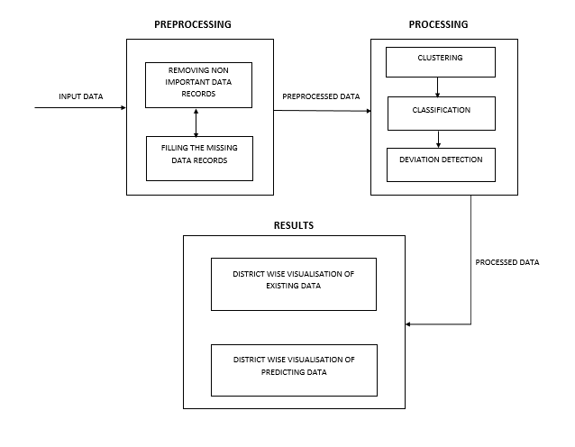
System Architecture

Slide 17
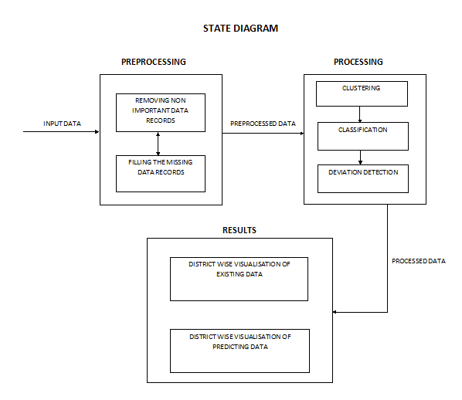

Slide 18
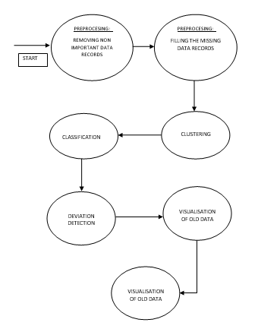
Flow Diagram

Slide 19
Implementation
Data preprocessing : Using R
Remove unwanted/ garbage values from the obtaned data sets
Fill the voids
Data Processing: Using R
Clustering
Classification
Deaviation Detection
Visualization : Using R and SAP Lumira
Visualized the processed data and the predictions using SAP Lumira and R

Slide 20
Conclusions
We find that most of the existing models have different pros and cons in their flexibility and assumptions. Since we have very few data points, we need to enforce sparsity. Since we are dealing with counts, we would like a poisson model, but in fact the data is overdispersed and hence a negative binomial might be a better choice. Different clustering, classification and deviation detection techniques are used for the precise anaysis and relationships of different crimes and demographic factors.

Slide 21
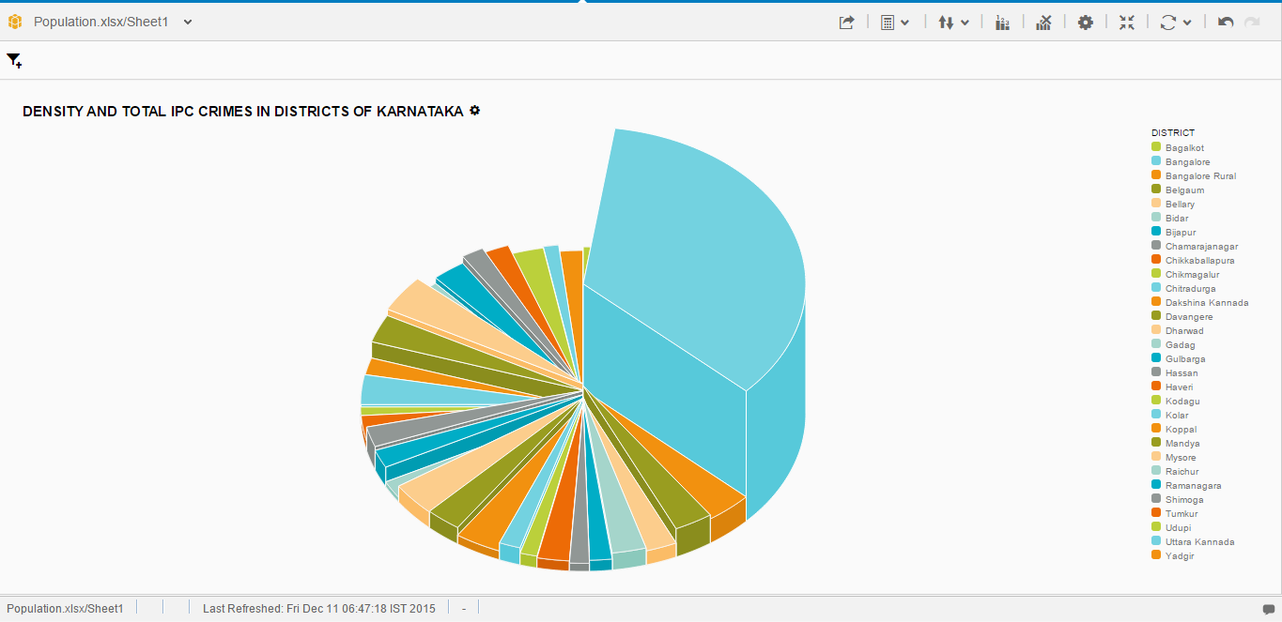
Results

Slide 22
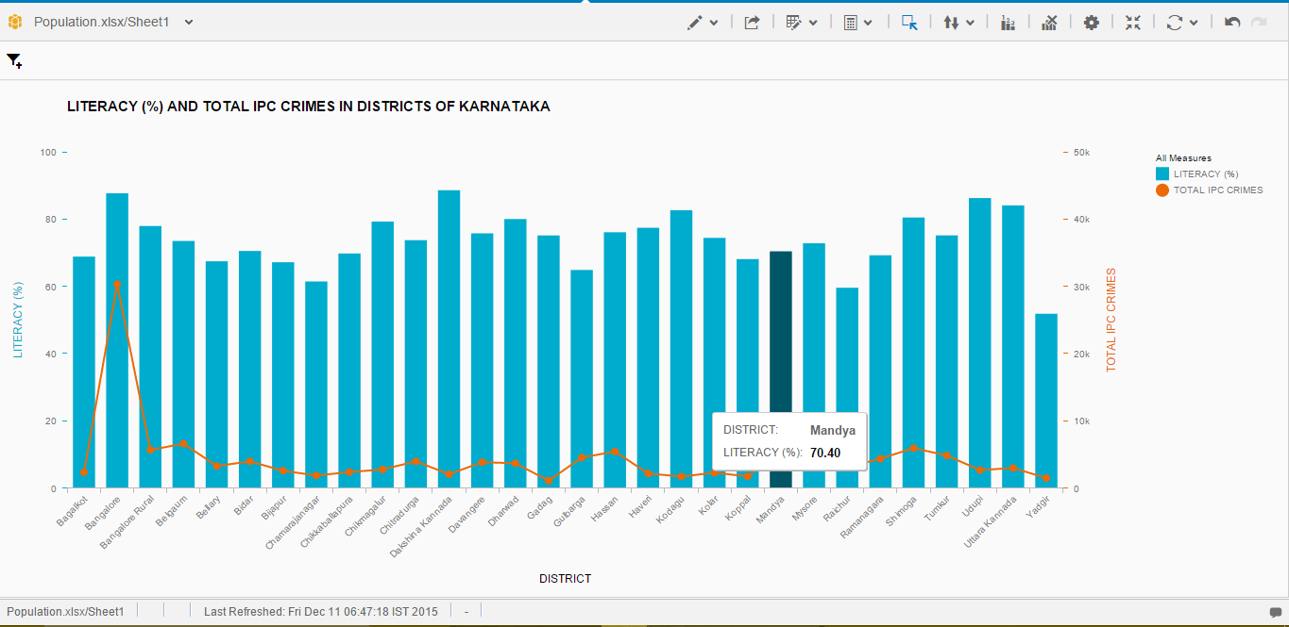

Slide 23
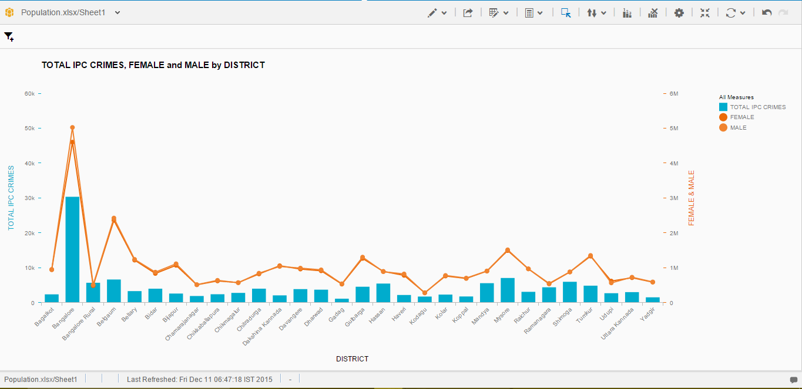

Slide 24
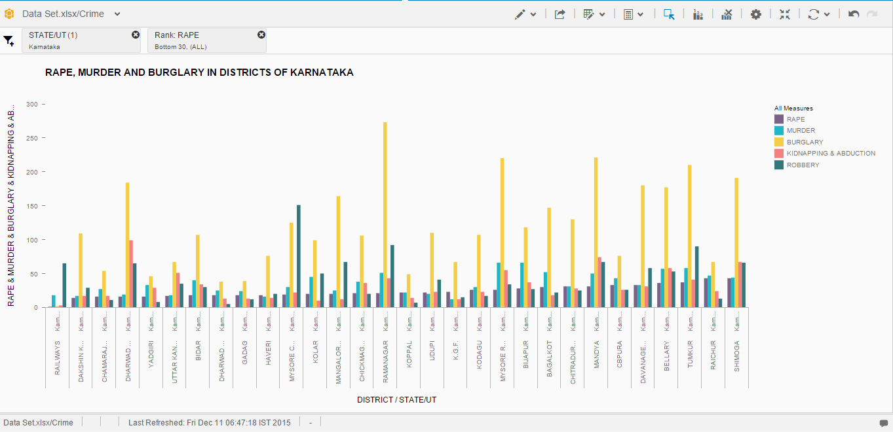

Slide 25
Bibliography
Data sets from data.gov.in
Abraham, T. and de Vel, O. Investigative profiling with computer forensic log data and association rules, Proceedings of the IEEE International Conference on Data Mining -ICDM'02, (2002) pp. 11-18.
Amarnathan, L.C. Technological Advancement: Implications for Crime, The Indian Police Journal, April June. (2003)
An Analysis of US Historic Crime Rates by Ari Lamstein, www.github.com
Brown, D.E. The regional crime analysis program (RECAP): A frame work for mining data to catch criminals," in Proceedings of the IEEE International Conference on Systems, Man, and Cybernetics.
Corcoran J.J., Wilson I.D. and Ware J.A. Predicting the geo-temporal variations of crime and disorder, International Journal of Forecasting, Vol. 19 (2003) 623-634.
David, G. Globalization and International Security: Have the Rules of the Game Changed?, Annual meeting of the International Studies Association, California, USA, (2006) http://www.allacademic.com/meta/p98627_index.html (July 10, 2011).

Slide 26
Bibliography
R documentation : www.r-project.org
R documentation: www.rdocumentation.org
Visualization using SSH: Shinyapps.io
Import data from an exteral source : quandl.com
SAP Lumira reference guide : www.cloud.saplumira.com

